Slide 1

Ruth Okoilu
An Introduction to Machine Learning
Ruth Okoilu
DLI

Slide 2
Goals
Understand the idea of Machine Learning (ML)
Understand the processes behind creating a real world ML system
Understand how the choice of ML algorithm affects the accuracy of created model

Slide 3
Target Audience
Anyone interested in building smart applications/software using ML but does not have any previous exposure to the field.
Prior experience with R or Python is helpful.

Slide 4
Definition and Overview of Machine Learning
Machine Learning is the subfield of computer science that, according to Arthur Samuel in 1959, gives "computers the ability to learn without being explicitly programmed.”¹
[1] Machine learning. (2017, July 18). Retrieved July 18, 2017, from https://en.wikipedia.org/wiki/Machine_learning

Slide 5
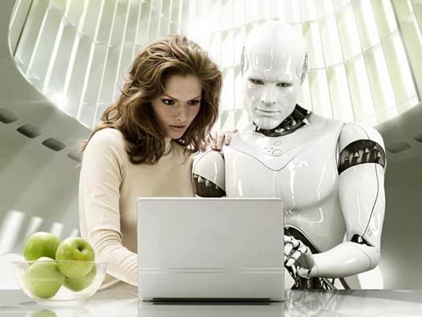
Basically, ML is...
teaching a machine how to perform learning tasks
science of teaching the machine to identify trends in data
make predictions on data
recognize patterns that cannot easily be detected by humans
Notes:
ML is basically teaching a machine how to perform learning tasks.
It is also the science of teaching the machine to identify trends, patterns,
hidden insights and relationships from data as well as make predictions on data.
Such patterns cannot easily be detected by humans.
Data to be learned could be text, database records, images, sounds,
location information, DNA Sequence.

Slide 6
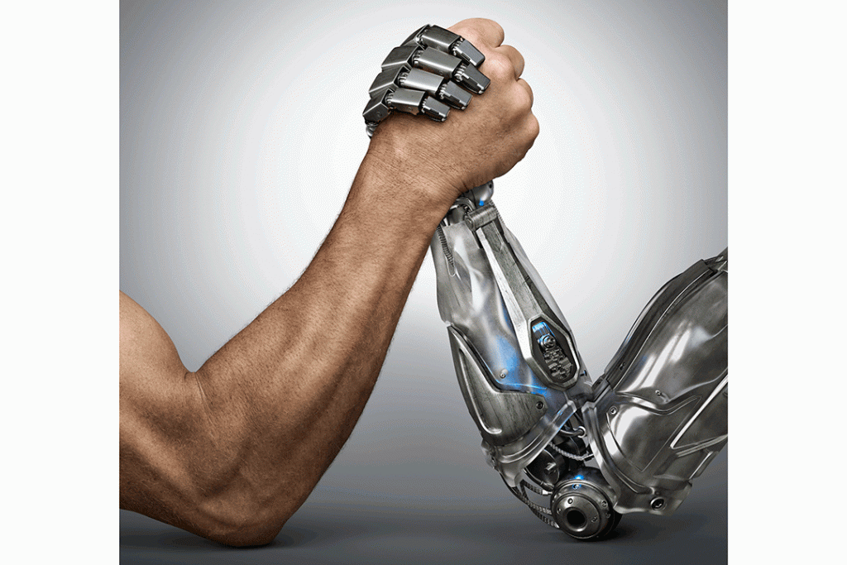
Human Brain vs Computer
Notes:
For example: A human can learn the voices of 10 co-workers and be able to identify them even without looking,
while a machine can learn the voices of 10 000 people and be able to predict whose voice it is.

Slide 7
Human Brain vs Computer
Human Brain | Computer
A human can learn the voices of 10 (maybe 100) co-workers and be able to identify them without looking | A machine can learn the voices of over 10,000 people and be able to predict whose voice it is.
Computer wins, How?
Answer = Machine Learning!!!
Notes:
The machine can do this using a model that takes in an input (a person’s voice),
does some processing and predicts the name of the person as the output.

Slide 8
MODEL
an artifact or a formula created by the process of learning from previous data.
takes in an input (a person’s voice), does some processing and predicts the name of the person as the output.
Notes:
The machine can do this using a model that takes in an input (a person’s voice),
does some processing and predicts the name of the person as the output.

Slide 9
MODEL
Training Data (Historical/Raw)
Model
=
+
ML Algorithm
Notes:
Historical data in our case is a bunch of audio records of each person’s voice pronouncing a set of words or phrases.
A good model depends on the size of data and the choice of ML algorithm applied.

Slide 10
Historical Data
bunch of audio records of each person’s voice
text
database records
images
sounds
spatial information
temporal
DNA Sequences etc.
Notes:
The data could be:
records of people’s voices or sounds
flat files or text,
Database tables
images, for example when you want to teach the computer to recognize a cat or even what a cancer cell looks like
sound for maybe sound classification, or predict number of people in the room based on the sound they make
the machine can also learn to process spatial information, for weather analysis across different locations
temporal - has to do with data that varies over time
DNA sequencing- for predicting order of nucleotides within a DNA molecule

Slide 11
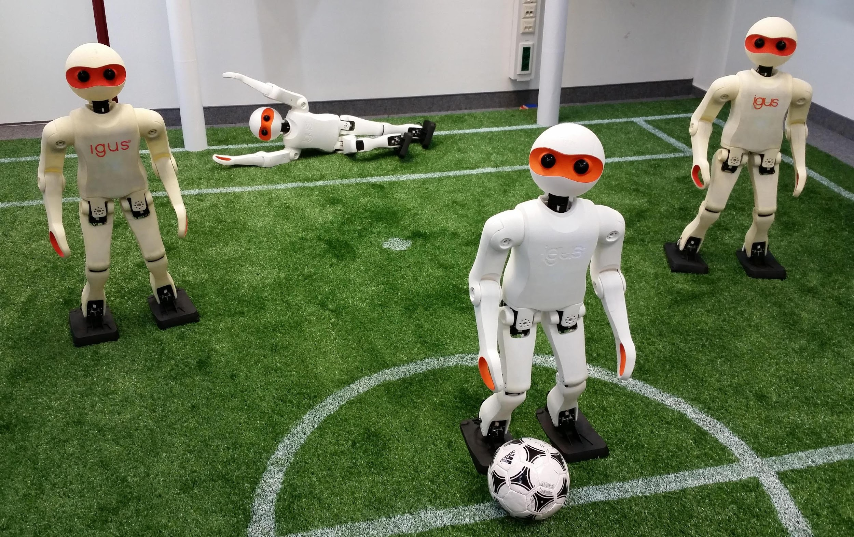
Computer Never Misses
teaching a machine how to score a goal at every attempt
learns from historical records of goal angles, kick intensity etc.
Notes:
Another example is teaching a machine how to score a goal on every attempt. Even professional soccer players record goal misses.
However, when a computer learns to score a goal, it never misses. Again, the machine is able to do this using a model created by learning from sufficient data (records of goal angles, kick intensity etc.) and a good ML algorithm.

Slide 12
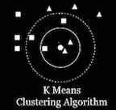
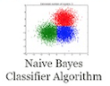
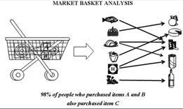

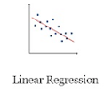
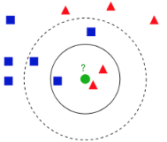
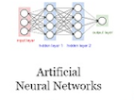

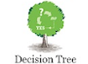
ML Algorithms
Apriori Algorithm
Nearest-Neighbor
Notes:
ML Algorithms are step by step learning methods for building a model
ML is quite broad. Many brains have tried to teach the computer to be smart. SOME of the approaches they have introduced include the following ML algorithms

Slide 13
How to Use ML as a Creative Tool
Building functions from experience is useful for the following:
Notes:
We experience the power of ML every day and all around us. From Weather forecast to detecting cancer, the computer has come a long way in its studies in a short time.
I’ll like anyone to suggests some applications of ML around us (interactive class)
You’ll be super excited to know that you’re learning ML as you’ll be able to do the following:

Slide 14
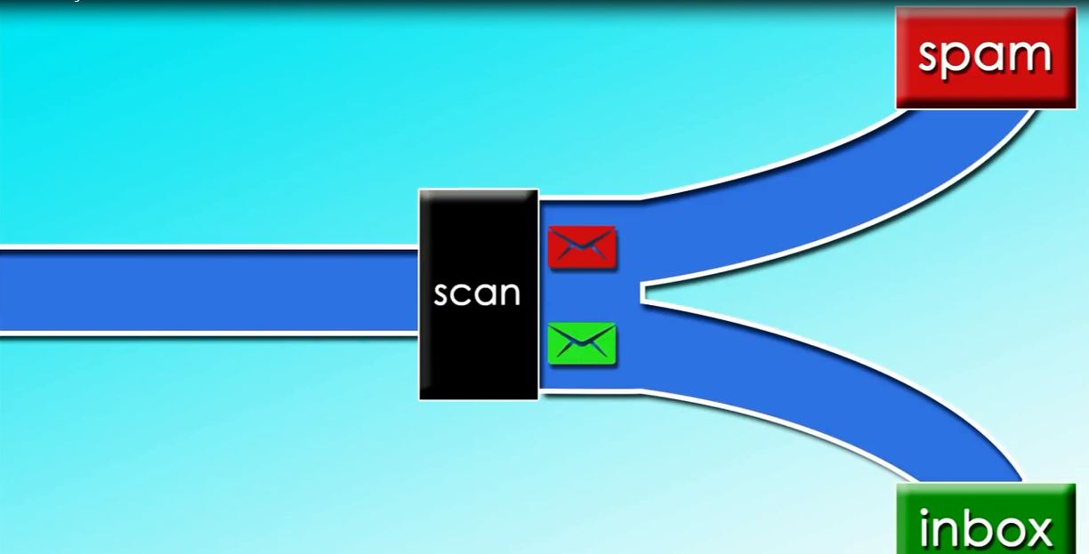
SPAM DETECTION
Notes:
Here a machine learning system is trained on email messages to learn to distinguish between spam and non-spam messages and classified into folders. By looking out for certain phrases, for example if the Subject of a message contains the text “Sale” or “Desire to be famous, TRY our...”, then the machine can classify as message as SPAM.

Slide 15
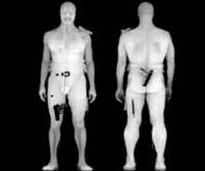
SECURITY AND CRIME DETECTION
Notes:
A machine learning system could be trained to recognize weapons and raise an alarm in case of emergencies.
Computer Vision is the science of teaching computer to see. This field has recorded tremendous progress and now smart cameras can detect guns and other dangerous objects in airport X-Ray imagery.¹
[1]Damashek, A., & Doherty, J. (2017). Http://ljournal.ru/wp-content/uploads/2017/03/a-2017-023.pdf. doi:10.18411/a-2017-023

Slide 16
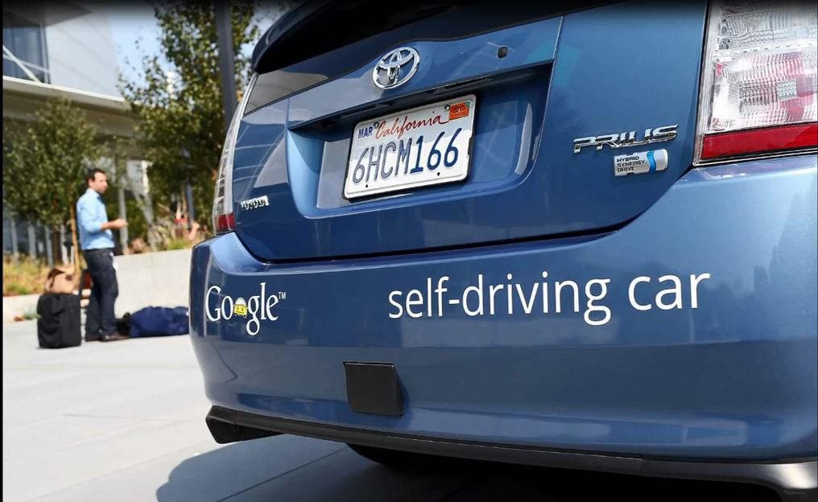
Self-driving cars

Slide 17
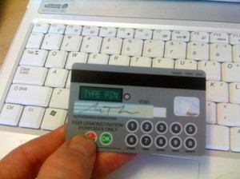
Credit Card Fraud Detection
Notes:
Using your credit card in a location other than the usual location or withdrawing an amount of money higher than a certain threshold will trigger an alarm. The threshold is determined by the machine.

Slide 18
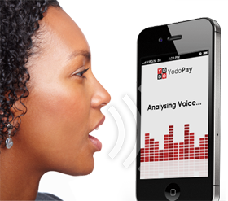
Speech Understanding
Notes:
Natural Language Processing (NLP) and understanding has to do with understanding speech and in context.

Slide 19
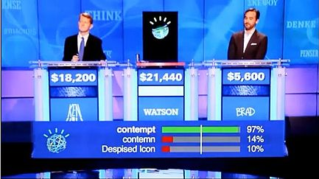
Watson Wins Jeopardy Quiz Show
Notes:
To learn more about NLP, check out IBM Watson’s record of winning the famous Jeopardy Quiz show. Watson was able to understand questions in context amidst:
Lexical/Syntactic Ambiguity, This type of ambiguity represents words that can have multiple assertions.
For instance,
Somebody complimented me on my driving today. They left a little note on the windscreen that said 'Parking Fine.'
E.g. 2
The fisherman went to the ​bank.
(The bank of the river or the commercial bank)
Semantic Ambiguity: This type of ambiguity represents sentences that can be parsed in multiple syntactical forms.
E.g. 1
Person 1: Call me a cab.
Person 2: Ok, you are a cab.
E.g. 2
Visiting relatives can be boring
As well as other ambiguities like Figures of Speech.
as well as others like figures of speech etc.

Slide 20
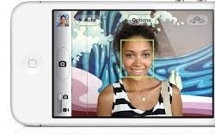
FACE RECOGNITION ON PHONE CAMERAS
Notes:
Face recognition in Cameras as well as PROXIMITY SENSORS to know when making a call. I used to have a cell phone whose back light went off when phone is place close to ear and comes on when phone is facing me.

Slide 21
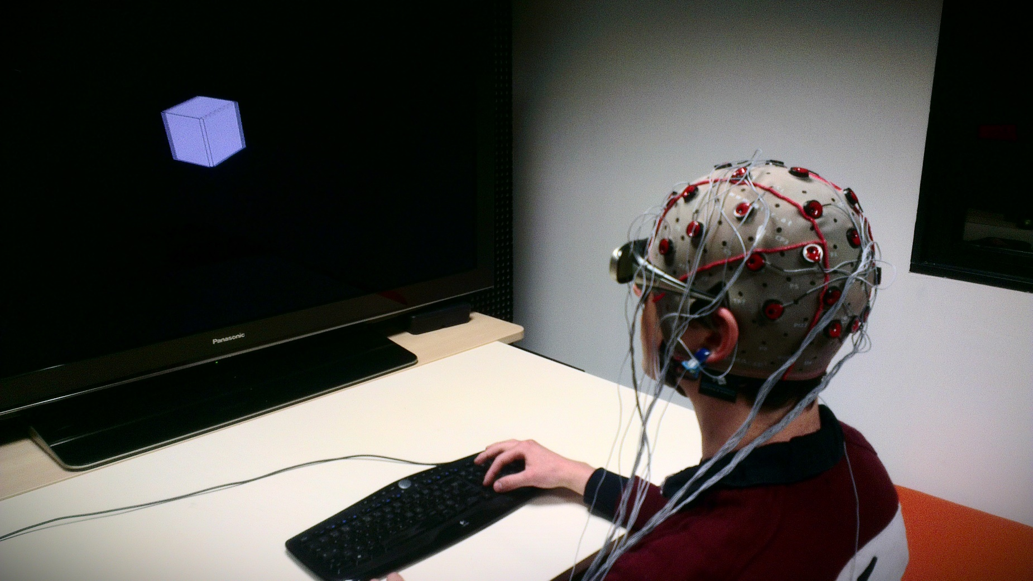
BRAIN MACHINE INTERFACES
Notes:
Medical application of ML: could be used to restore mobility in paralyzed limbs by electrically stimulating muscles

Slide 22
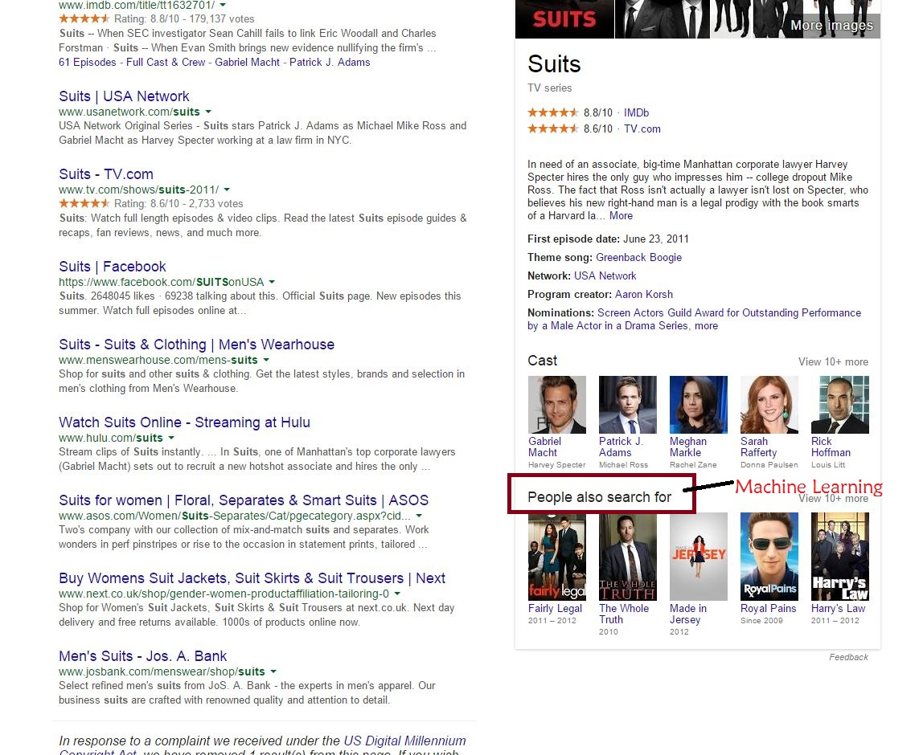
Notes:
ML is used by Google, Facebook, Microsoft, Amazon, Walmart and the likes for various tasks including recommendation systems, market basket analysis etc.

Slide 23
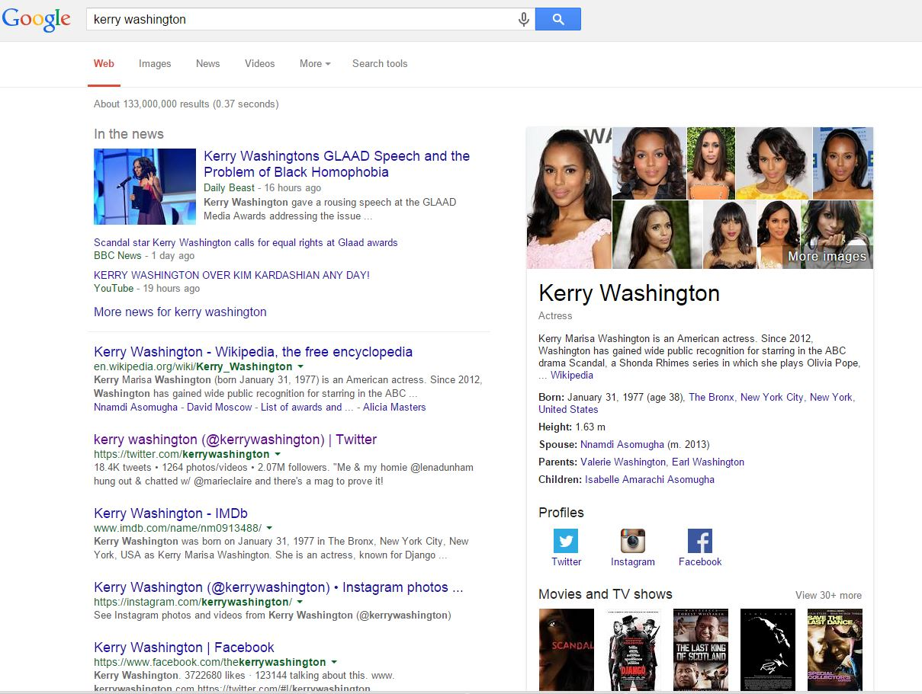
Notes:
Machine learning is a very exciting field, and while lots of improvement is being made in this field and applied by various Original Equipment Manufacturers (OEM) such as Google, Apple and the likes…
there is room for improvement.

Slide 24
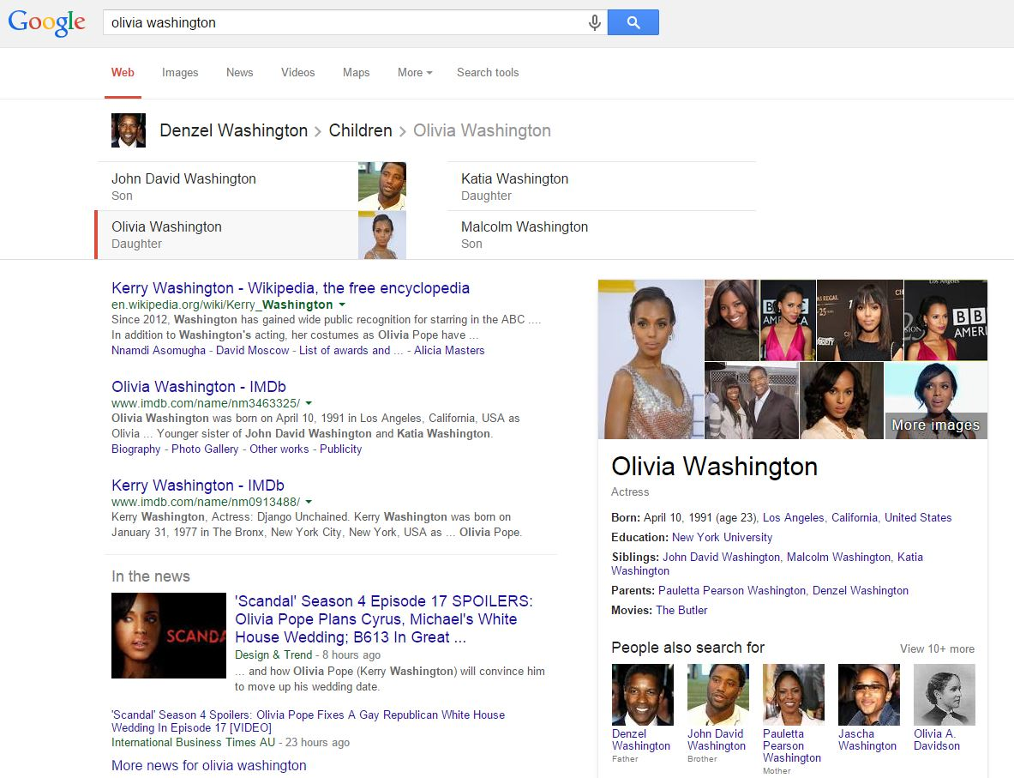
Gave more weight to Kerry Washington’s picture when the search was for Olivia Washington
Notes:
Some time ago I made this google search for Olivia Washington and the first picture that popped out was a wrong one… that of Kerry Washington. Was in 2015. If you search now it has been corrected.

Slide 25
Two Major Ways to Classify ML Problems/Tasks
Feedback available to the learning system
Application of the desired system
Notes:
In Computer Science, we are always trying to solve a problem:- creating a smart machine that scores at every attempt, voice recognition applications, automatic vacuum cleaners, self-driving cars etc. These problems can be classified into broad categories depending on:
Feedback available to the learning system
Application of the desired system

Slide 26
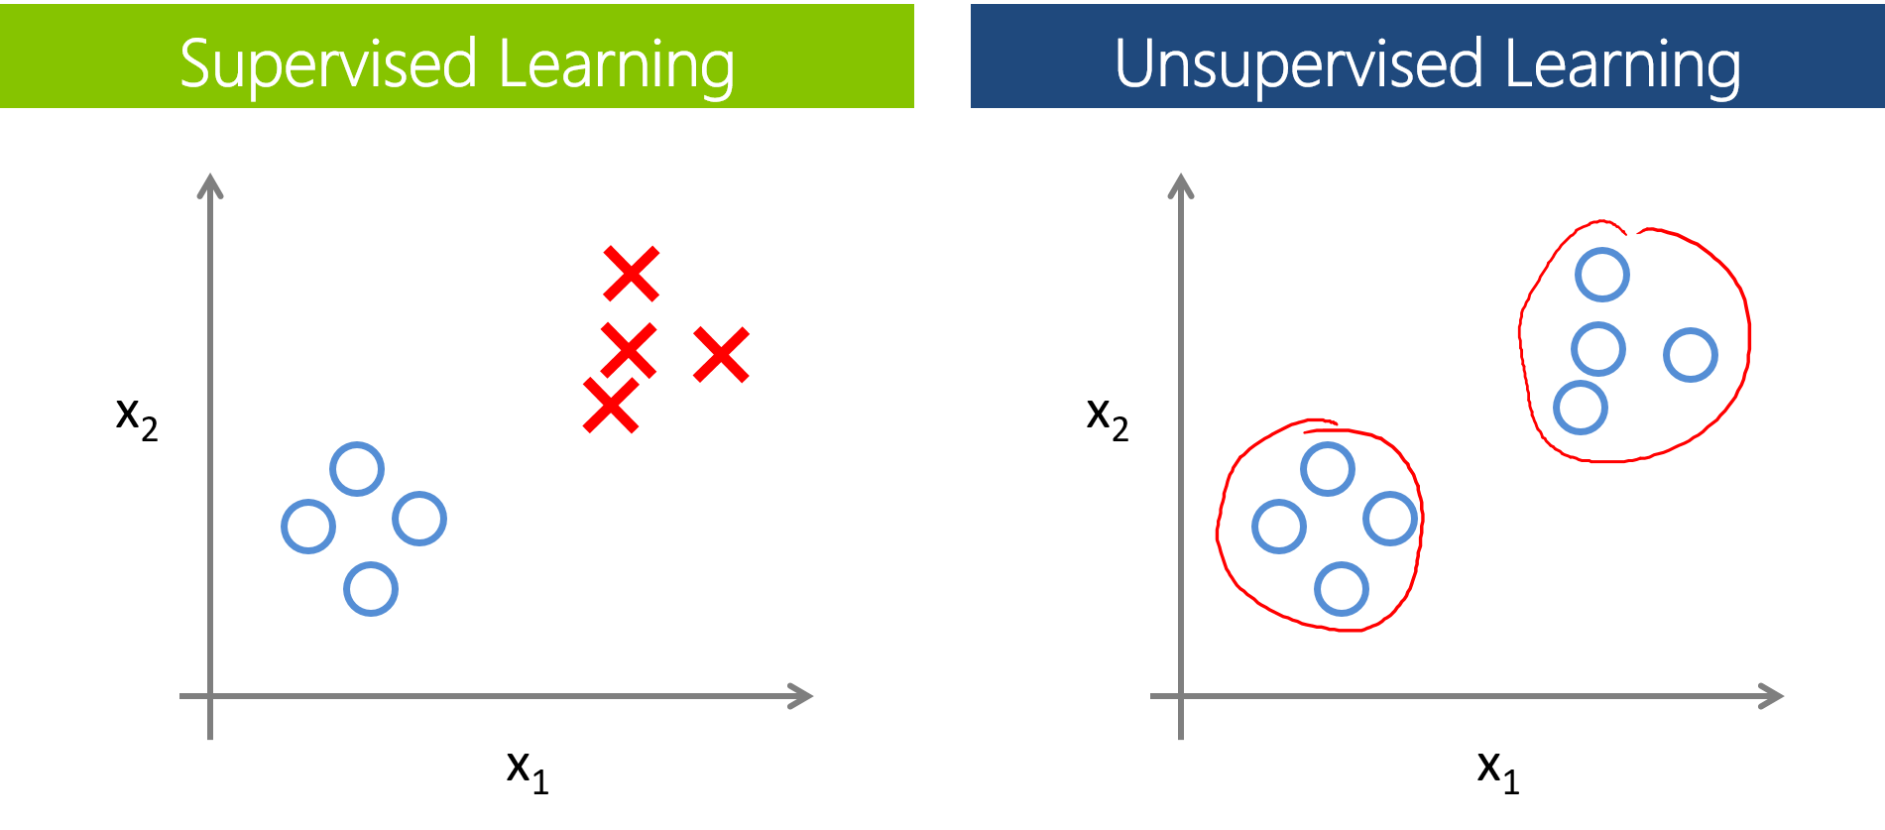
ML Tasks classified Based on Feedback Available
Notes:
Supervised Learning: This category contains problems where the machine is immediately provided with sample inputs and their desired outputs. The machine then comes up with a model to map new inputs to correct outputs. For example: Let’s say attribute X1 contains the height of different flowers and X2 is the width of their petals. Also, let’s say the blue circles are bonsai flowers and the red X’s are sunflowers (tall large petals). In this type of learning, the machine will be provided with the type of flower i.e. the data will indicate that blue circles are bonsai and red X’s are sunflower. The computer then comes up with classification criteria (model) to learn more about each flower. These criteria could be, any flower with height above 7 feet and petal width above 5 inches is a sunflower else it’s a bonsai.
Semi-supervised Learning: Some but not all sample inputs have output.¹ have combining labeled and unlabeled data has been found to produce improvement in learning accuracy
Unsupervised Learning: The machine is not provided with sample inputs and their desired outputs. The machine has to come up with a formula for categorizing data.
From our example of sunflowers and bonsai, here, the machine is not given the names of the dot. Its task is to detect the number of groups/clusters present in the distribution. There are clearly 2 groups in this example and the computer notes the characteristics of the 2 groups (creates a model). So that if a new data comes in, it can accurately classify the new point into the right group.
A human can see 2 groups as well, however, for complex datasets with more than 2 attributes or predictors (not just X1 and X2), it will be difficult for the human to notice the distinct groups.
Reinforcement Learning: The machine is provided with an environment in which it
must perform a certain goal for example win a soccer game or drive a vehicle. Sample goals are provided as well as feedback which are in form of rewards and punishments.
For example, playing a game of chess, the computer is provided with feedback in form of rewards. E.g. after moving one step forward, moving the pawn 2 steps to the right carries 5 more points than moving 1 step to the left etc. The computer can then make its decision from these rules in such a way to maximize its rewards and eventually win the game.
[1] Semi-supervised learning. (2017, July 17). Retrieved July 18, 2017, from https://en.wikipedia.org/wiki/Semi-supervised_learning

Slide 27
Second Classification
It is believed that all machine learning tasks fall under any of the following:
Classification
Clustering
Association Rule Discovery
Anomaly Detection
Notes:
Classification [Predictive] – A classification problem requires identifying which category a new observation belongs. For example, …
Clustering [Descriptive] - This task requires a division of the data set into groups (Draw examples like the machine should know that this is a group this is a group etc. by using the model it has created)
Association Rule Discovery [Descriptive] – This task requires the machine to discover interesting relations between variables in databases
Deviation Detection [Predictive] – Seeks to detect anomalies, and outliers. You logged onto Gmail while visiting Paris. The machine has all your login audit trail. The login attempt in Paris stands out. You get a mail… So also using your credit card (Draw graph of outliers)
The type of problem will determine what approach should be used to solving it.

Slide 28
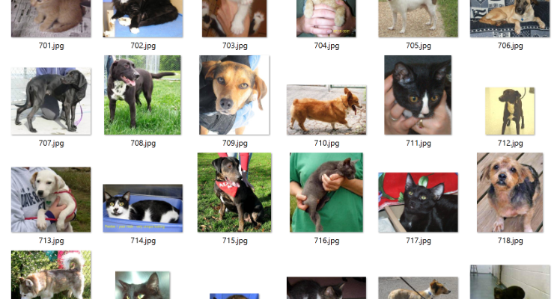
Classification
Notes:
Classification [Predictive] – An example of a classification task computer is trained with a dataset of cats and dogs.

Slide 29
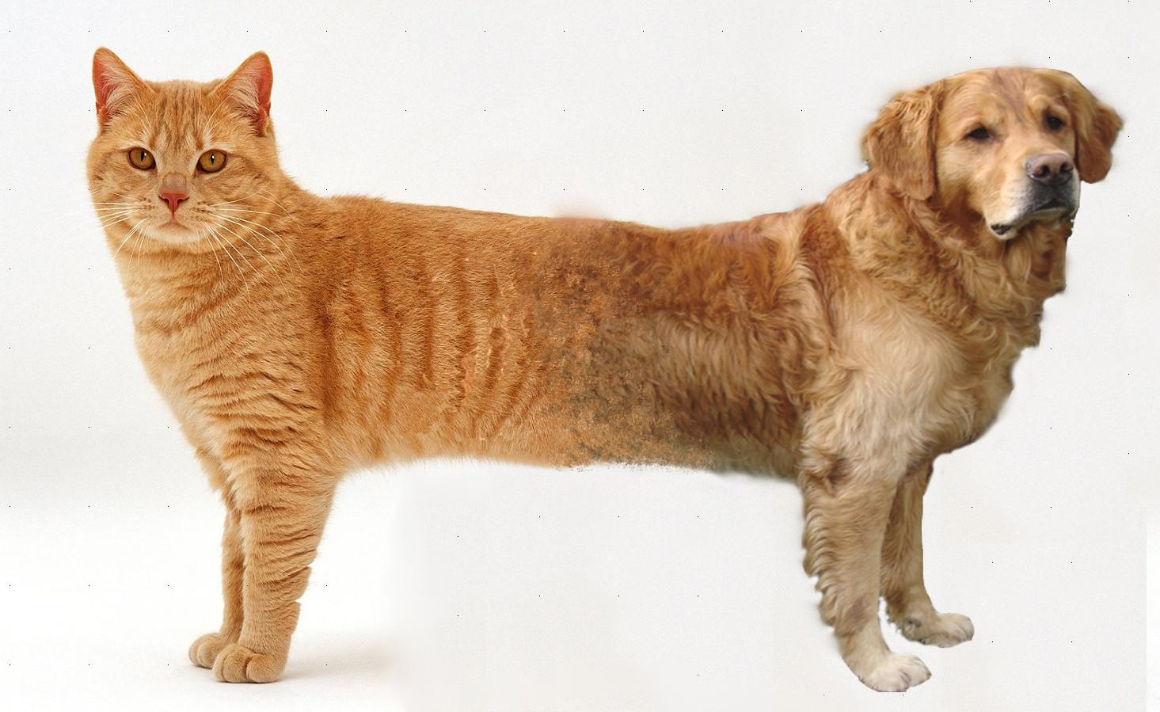
Computer, what is this?
Image credit: Collet, S. (n.d.). Machine Learning for Grandmas. Retrieved July 18, 2017, from https://www.saagie.com/blog/machine-learning-concepts-overview
Notes:
Classification [Predictive] – And is asked to classify this image into the cat or dog group. On a lighter note, our model will fail either way.

Slide 30
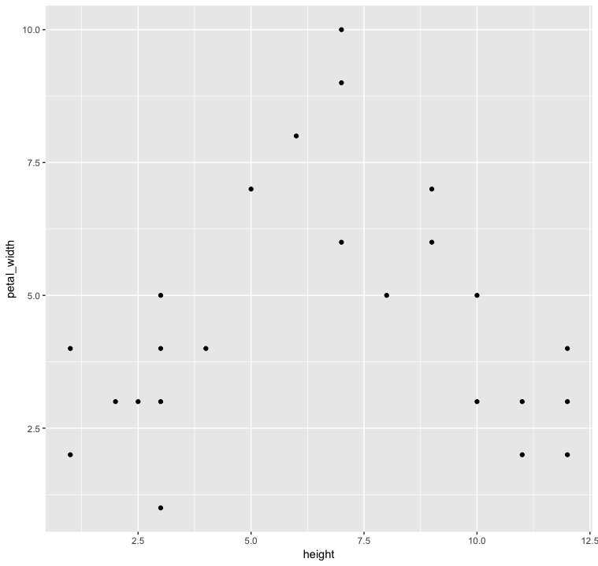
Clustering
Notes:
Clustering [Descriptive] - Can you tell how many groups of flowers are here?

Slide 31
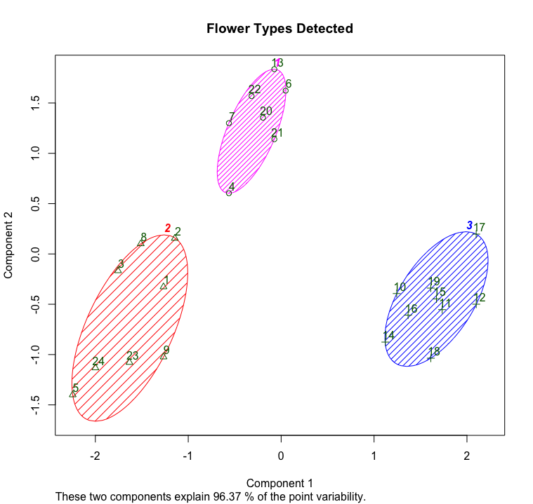
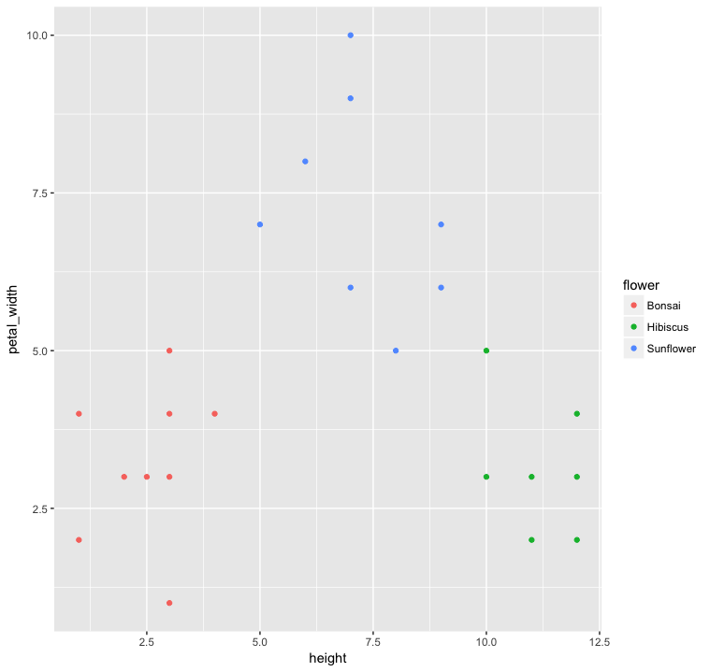
Using KMeans Clustering Algorithm
Notes:
Clustering [Descriptive] - Using Kmeans clustering algorithm, we arrive at an accurate number of 3 clusters

Slide 32
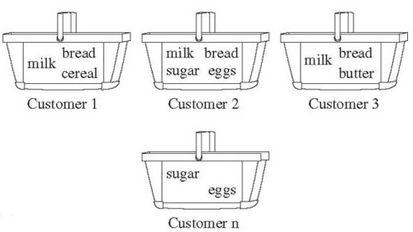
Association Rule Mining
Notes:
Association Rule Discovery [Descriptive] - This is a market basket analysis example. If you have a Machine Learning related job with Walmart, you will be sure to advise they put milk close to the bread aisle or sugar close to eggs. This kind of problem seeks to discover patterns and create rules from data.

Slide 33
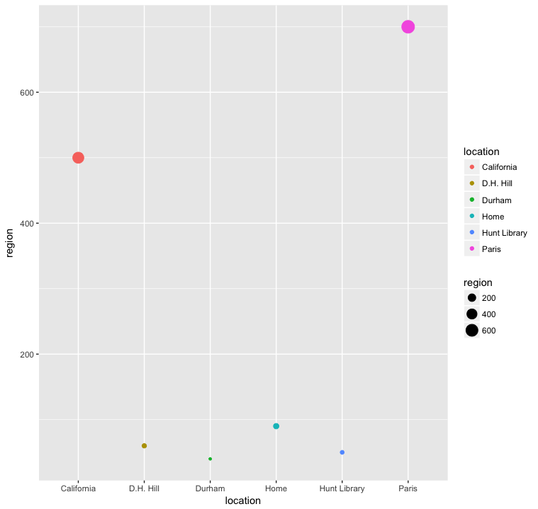
Deviation Detection
Notes:
Deviation Detection [Predictive] - For example, Gmail detects a login from Paris or California and sends you a mail because these records and outliers and a deviation from your normal region. A region of more than 200 is flagged.

Slide 34
ML Algorithms
Apriori Algorithm
Nearest-Neighbor
Notes:
There are so many ML algorithms. We’ll be learning
For the scope of this workshop, we’ll be treating:
General Linear Model (Regression)
Random Forest Algorithm (Decision tree learning Approach)
Come back to this latter

Slide 35
Main Processes Involved
Get data
Preprocess (Clean, Prepare, Manipulate Data & Exploratory Data Analysis)
Train Model
Test Model
Post-Process (Visualize, Evaluate, Improve Model & Present)
Notes:
This step involves finding the raw data in whatever format they are. They may be structured, unstructured, semi structured, whether flat files, tables, JSON format or in a database, video, audio, text etc.

Slide 36
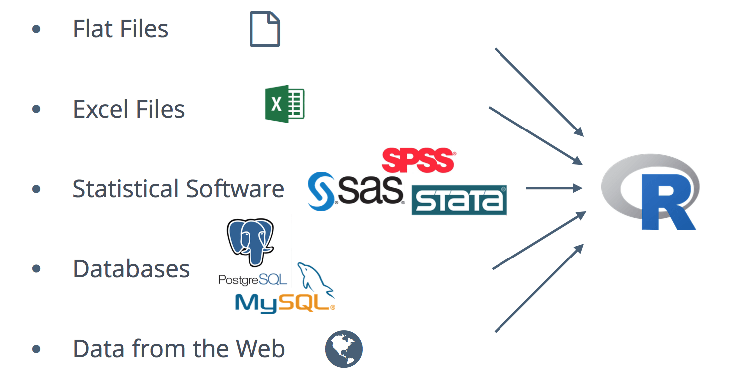
Get Data
Notes:
Getting into the data into the statistical tool (R, Python, Matlab, SAS, WEKA etc.) you will be using for analysis and putting it in the right format.

Slide 37
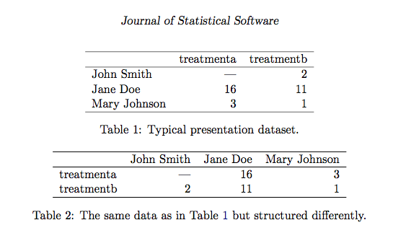
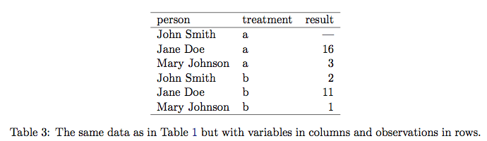
Cleaning Data
Compare the following tables:
WICKHAM, Hadley . Tidy Data. Journal of Statistical Software, [S.l.], v. 59, Issue 10, p. 1 - 23, sep. 2014. ISSN 1548-7660. Available at: <https://www.jstatsoft.org/v059/i10>. Date accessed: 28 june 2017. doi:http://dx.doi.org/10.18637/jss.v059.i10
Notes:
Cleaning data involves transforming data into a basic form that makes it easy to work with. One characteristics of a tidy dataset is that: one observation per row and one variable per column

Slide 38
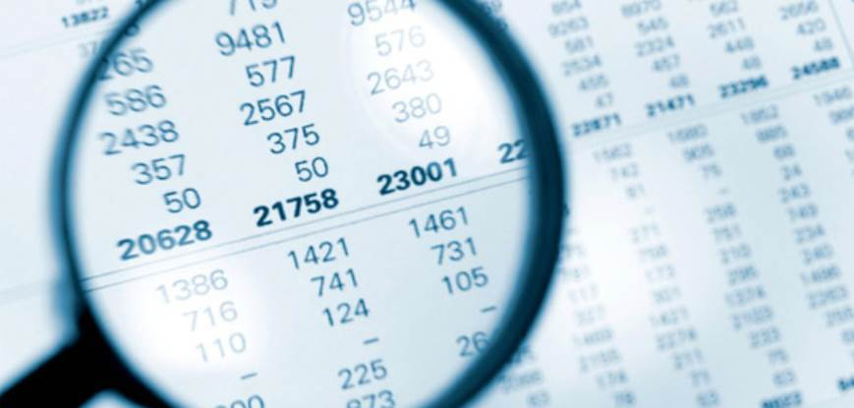
Checking Data Quality
Notes:
This has to do with detecting the presence of missing (NA) values, noise and outliers, or duplicate data, sampling error (when the sample of data used for analysis is biased – does not represent the whole population).

Slide 39
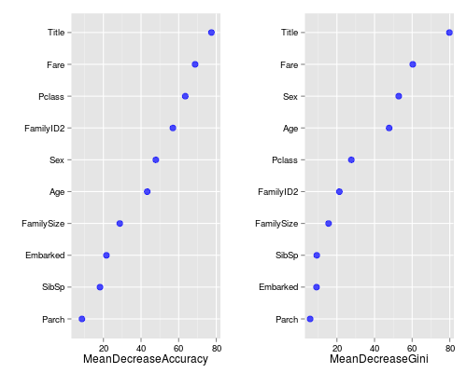
Dimensionality reduction & Feature Engineering
Notes:
Datasets may have a large number of attributes but not all attributes in a dataset affect is useful for analysis. There are techniques to discover attributes that will not help analysis. For example: Having both variables date of birth and age as columns in a dataset. The type of analysis will determine which columns to remove and which to keep.
The graphs above show methods used for Dimensionality reduction where we find the meanDecreaseAccuracy and meanDecreaseGini. This graph is gotten when you use the following function in R :
varImpPlot(fit)
where fit is the ML model gotten from Random Forest Algorithm and the Titanic data as in:
fit <- randomForest(as.factor(Survived) ~ Pclass + Sex + Age + SibSp + Parch + Fare + Embarked + Title + FamilySize + FamilyID2, data=train, importance=TRUE, ntree=2000)¹
This method is complex in that, it is used after the model has been created to further improve the model.
After the model has been created, the accuracy measure tests to see how worse the model performs without each variable, so a high decrease in accuracy would be expected for very predictive variables.
The Gini measure digs into the mathematics behind decision trees, but essentially measures how pure the nodes are at the end of the tree. Again it tests to see the result if each variable is taken out and a high score means the variable was important.
Title variable was at the top for both measures. Title was important in deciding whether one survived the Titanic or not. over 70% of Mrs. survived.
From the graph above, we can leave out Parch in future analyses and hope we get a higher accuracy.
This stage also has to do with reducing the dimension in terms of rows/quantity. There is a concept called curse of dimensionality. In order to avoid this, our learning algorithm can be made to operate in a space where data happen to lie on a low-dimensional manifold.²
[1] Stephens, T. (2014, January 18). Titanic: Getting Started With R - Part 5: Random Forests. Retrieved July 18, 2017, from http://trevorstephens.com/kaggle-titanic-tutorial/r-part-5-random-forests/
[2] Introduction to Semi-Supervised Learning. Retrieved July 18, 2017, from https://mitpress.mit.edu/sites/default/files/titles/content/9780262033589_sch_0001.pdf

Slide 40
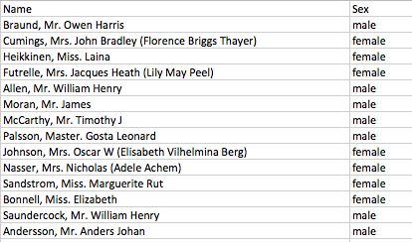
Dimensionality reduction & Feature Engineering
Notes:
Feature Engineering involves creating a subset of the whole dataset for analysis based on our goal. It also means creating new attributes. For example:
In the dataset above, the Column “Name” can be split into two columns - Name and Title. We can extract title from the Name column if we believe that the status of each subject affects our analysis.
Exploratory Data Analysis
This is required because you might want to plot the data while doing all dimension reduction or some other data cleaning activities. To see how each attribute affects our goal.

Slide 41
Main Processes Involved
Get data diagram… excel DNA sequence audio into R
Get data
Preprocess (Clean, Prepare, Manipulate Data & Exploratory Data Analysis)
Train Model
Test Model
Post-Process (Visualize, Evaluate, Improve Model & Present)
Notes:
It is Machine learning practice to partition dataset to be used for analysis into Training and Test sets.
The training set could be 60 - 70% of the entire dataset while the test set is the percentage remaining.

Slide 42
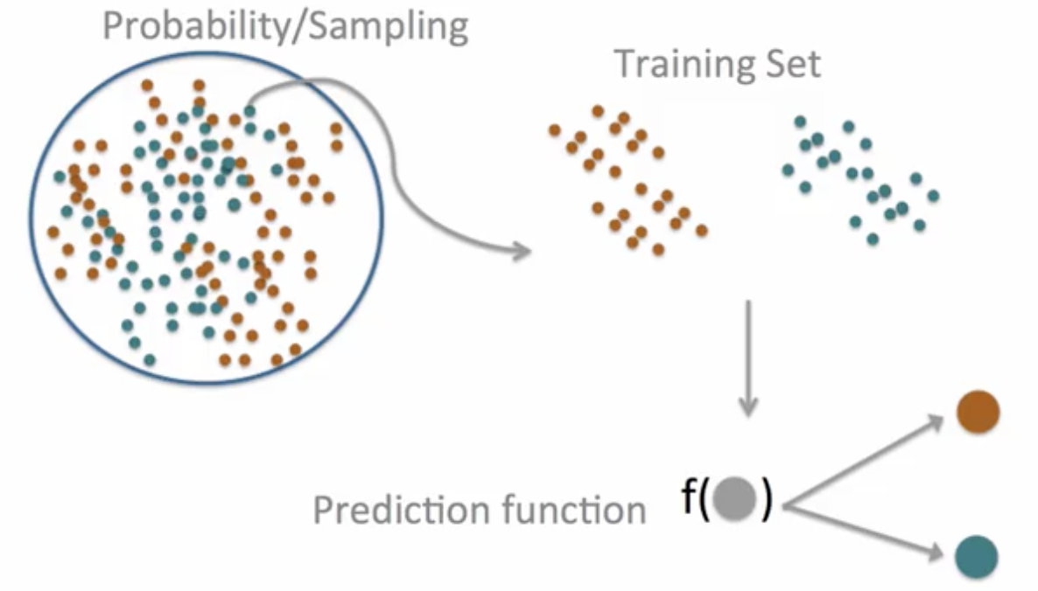
Train Model
5
5 Practical Machine Learning (Coursera)
Notes:
Let’s say we want to create a model (a.k.a Prediction function) such that given a new dot, our function can predict if the dot is a red or blue dot. The training set is chosen from the entire dataset using Probability and Sampling. Our chosen algorithm is used to learn from the training set what characteristics make a dot blue or red. These characteristics are used to build our prediction function.
Question for audience: Can someone say what type of Learning task this is based on the first classification?
Answer: This is supervised learning, as we can see they told us the color of each dot (feedback). In unsupervised, the color of the dot will not be given. The machine has to use other variables to distinguish if there are 2, 3 or more types of dots here. If the machine can predict 2 clusters of dots and correctly place each dot in the right group, then we say the Model is good; but if the machine says there are 4 types, then our model is not accurate.

Slide 43

Test Model
Notes:
The model created in the previous step is applied / tested in this step. In our case our test set are the remaining dots fed into our model without providing the model with color information. The ability of our model to precisely classify the test set into blue and red dots will determine how accurate our model is.
Again based on the second classification, this dot example is a classification task.

Slide 44
Main Processes Involved
Get data
Preprocess (Clean, Prepare, Manipulate Data & Exploratory Data Analysis)
Train Model
Test Model
Post-Process (Visualize, Evaluate, Improve Model & Present)
Notes:
If the accuracy of the model is satisfying, we can go ahead and predict the colors for dots whose colors are truly unknown, and visualize our forecast else we seek to improve the model by using other algorithms, improving our dataset and do some more feature engineering.

Slide 45
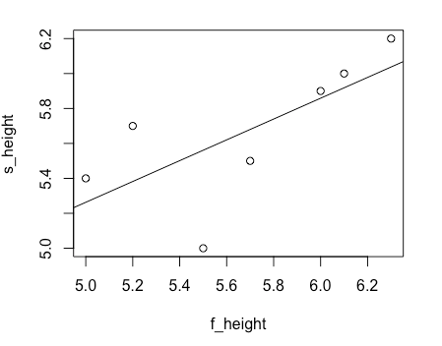
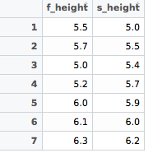
Hands-on Exercises
Exercise 1: Does Money Buy Happiness?
Correlation Between Salary and Employee Satisfaction
Link to R and Python Code
Regression modelling is used to find equations that fit data
y = a + bx
Notes:
This is an example of how to perform Linear regression modelling. We intend to fit a simple regression model. This model is a line.
Regression modelling is used to find equations that fit data
y = a + bx
y is what we want to predict and x includes all the predictors required to form the model above.
a and b are coefficients determined by the LM function
Regression model is easy to implement but it often produces low performance models. This method is useful when the variable involved can be modelled in a linear way. As a function of lines. For example, increase in age leads to increase in weight, or increase in age leads to decrease in the number of hairs on head. But cannot be used in showing increase in library visitor per day of the week. (1,2,3,4,5,6,7) – Non linear

Slide 46
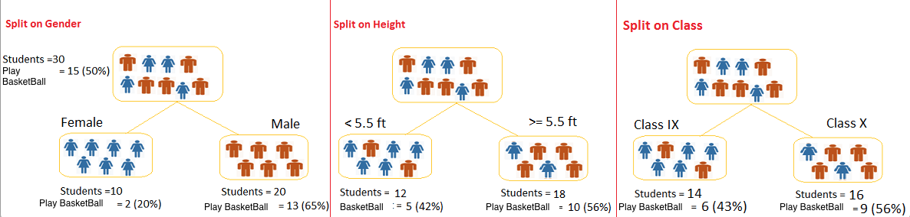
Hands-on Exercises
Exercise 2:
Predict Wage based on age, education, job class
Random Forest Algorithm
Link to R and Python Code
Notes:
Decision tree is a type of supervised learning algorithm that is mostly used in classification problems. In this technique, we split the population or sample into two or more subpopulation based on most significant splitter / differentiator in input variables.
Let’s say we have a sample of 30 students with three variables Gender (Boy/ Girl), Class( IX/ X) and Height (5 to 6 ft). 15 out of these 30 play Basketball in leisure time. Now, I want to create a model to predict who will play basketball during leisure period? In this problem, we need to segregate students who play basketball in their leisure time based on highly significant input variable among all three.
This is where decision tree helps, it will segregate the students based on all values of three variable and identify the variable, which creates the best homogeneous sets of students (which are heterogeneous to each other). In the snapshot below, you can see that variable Gender is able to identify best subpopulation sets compared to the other two variables.¹
This is the same method used for our Wage example. Predicting wage based on age, education and job class.
^{[1]} Team, A. V., N., Jain, S., & Bansal, S. (2017, May 01). A Complete Tutorial on Tree Based Modeling from Scratch (in R & Python). Retrieved July 18, 2017, from https://www.analyticsvidhya.com/blog/2016/04/complete-tutorial-tree-based-modeling-scratch-in-python/

